Slide 1

Book Recommender System
Presented
By
Dhruv Garg 2210990273
Divyansh 2210990298
Gagan Deep 2210990310
Faculty Coordinator : Dr. Jatin Arora
Chitkara University Institute of Engineering and Technology,

Slide 2

Contents
Introduction
Motivation of Research
Tools & Technologies
Project Highlights: 1
Project Highlights: 2
Conclusion/Theme Plan
References

Slide 3


Introduction
Welcome to our project, where innovation meets the love of literature. Our goal is simple yet profound: to redefine the way readers discover their next favorite book.
Powered by advanced data analysis techniques and machine learning algorithms, our system promises to revolutionize the book discovery experience, ushering in a new era of literary exploration and enjoyment. Join us on this exciting journey as we unveil the magic of personalized book recommendations.

Slide 4

Motivation of Research
Our book recommender system emerged from a desire to revolutionize the way readers discover and engage with literature.
Inspired by the principles of legality, user-friendliness, and personalized content recommendation.
By leveraging advanced AI algorithms, our system analyzes users' preferences and reading habits to offer curated book recommendations tailored to their unique tastes.

Slide 5
Tools & Technologies
1. Python Libraries:
NumPy: Efficient numerical computations and data manipulation.
Pandas: Data analysis, manipulation, and organization within data structures.
Matplotlib.pyplot and Seaborn: Data visualization for analysis and interpretation.
2. Jupyter Notebook:
Used as the primary integrated development environment (IDE) for writing and executing code.

Slide 6


3. Kaggle:
Acted as a valuable resource for accessing datasets relevant to our book recommender system.
4.GitHub: A version control system and collaboration platform used for managing project code, tracking changes, and facilitating teamwork among developers working on the Project.
5.Visual Studio Code (VS Code): A popular code editor with features like syntax highlighting, code completion, and debugging tools.

Slide 7
6. K-Nearest Neighbors (KNN) Method :
Utilized for recommendation system implementation.
Implementation facilitated by Scikit-learn library in Python.
Enables personalized book recommendations by identifying similar books based on user preferences.
7. Cosine Similarity Method:
Employed for recommendation system implementation.
Metric used for measuring similarity between two non-zero vectors.
Implemented using Scikit-learn library in Python for efficient computation.

Slide 8
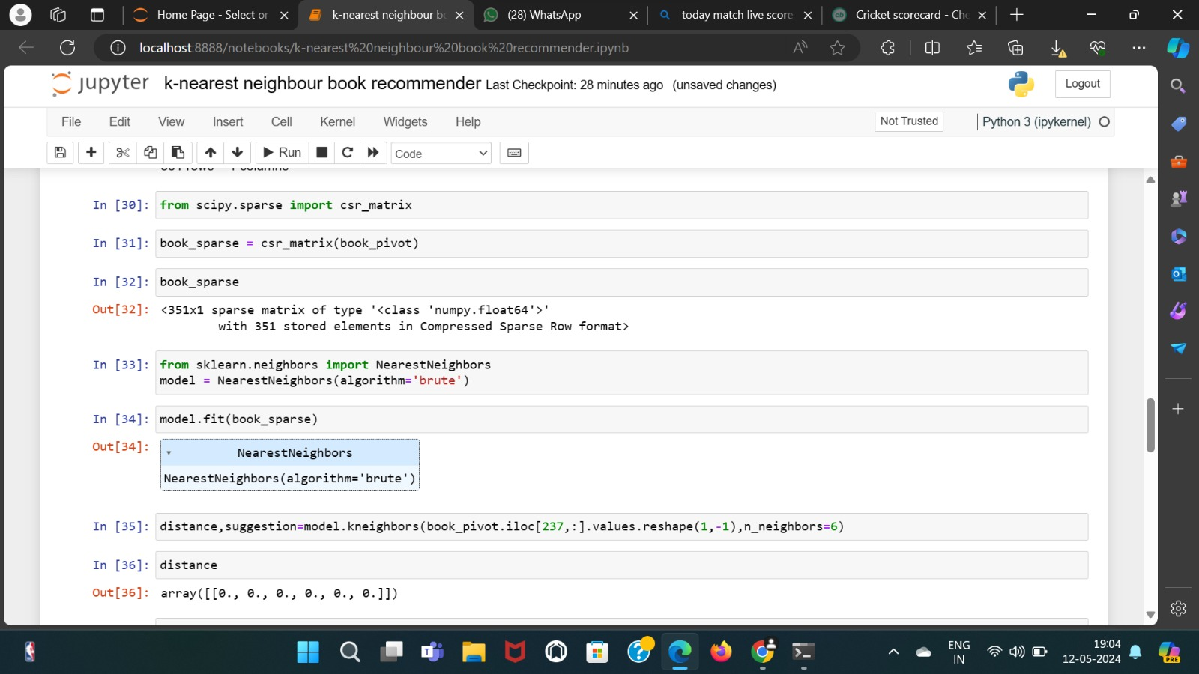
Project Highlights : 1 (k-neighbour)
Here is some snapshots of our code that we use in our book recommender project:

Slide 9
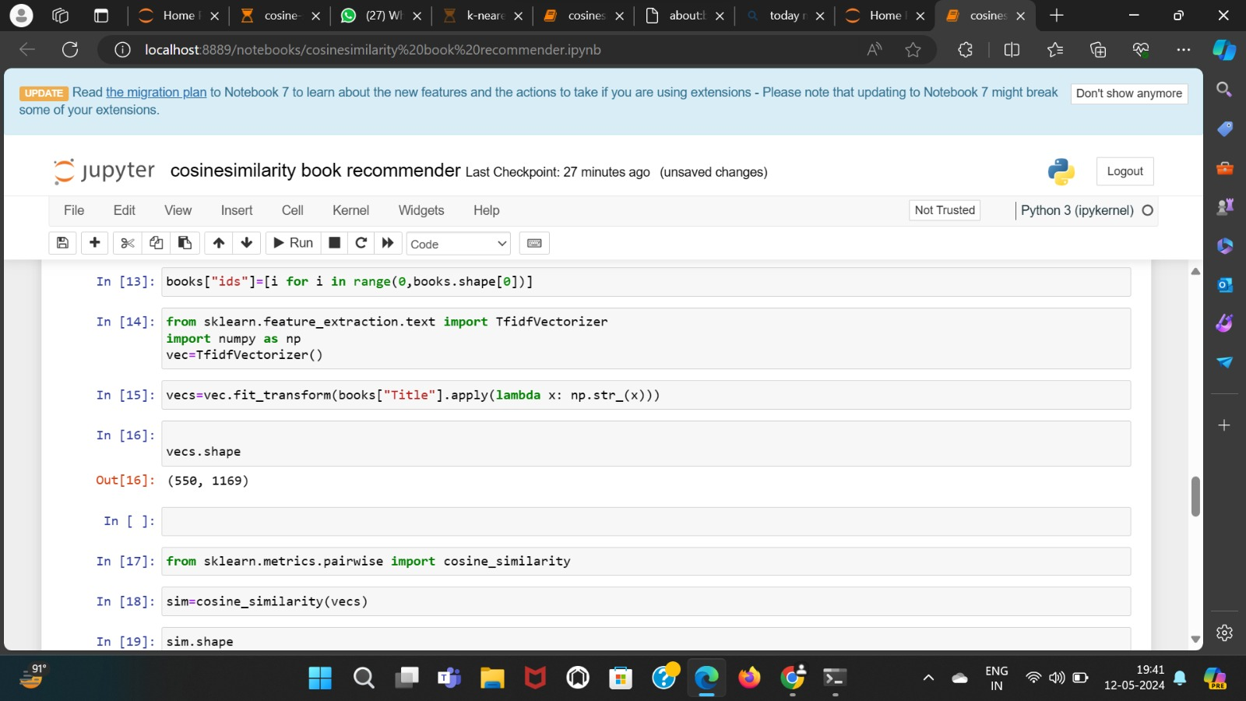
Project Highlights : 2 (Cosine Similarity)

Slide 10
Conclusion/Theme Plan
Successfully implemented K-Nearest Neighbors (KNN) and Cosine Similarity.
1. Created a robust book recommendation system for personalized recommendations.
2. KNN method identified nearest neighbors for books, enhancing suggestion accuracy.
3. Cosine Similarity calculated similarity scores between titles, improving recommendations.
4. Revolutionized user experience in discovering and engaging with literature.
5. Ongoing exploration and refinement of recommendation algorithms for further optimization.

Slide 11
References
https://www.w3schools.com/js/
https://stackoverflow.blog/2019/09/12/practical-ways-to-write-better-javascript/

Slide 12
Thank You

